Slide 1






AIRLINE SENTIMENT ANALYSIS

Slide 2

What do we know about U.S Airlines
Around 100 passenger airlines operate over 11 million flights per year.
US flights contribute to one-third of the world’s total air traffic.
More than 700 million passengers travel in these airlines across US per year.
Airline industry generates around $160 billion in revenues.

Slide 3
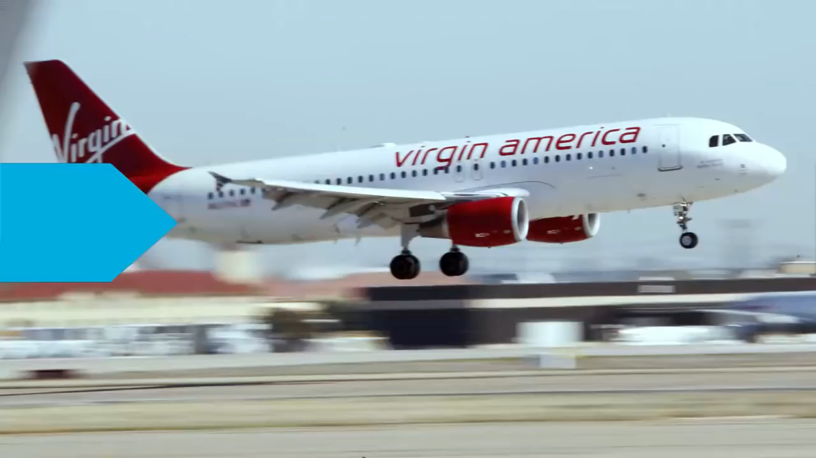
Performance Matters !!
“Customer Satisfaction” plays a huge role.
Challenge ?
Analyzing the customer satisfaction by “Twitter Sentimental Analysis”

Slide 4
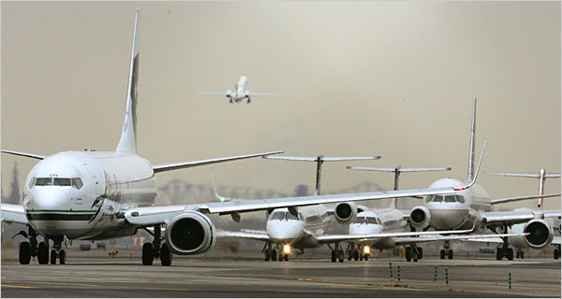
Our Approach !!
Naïve Bayes Classifier
Simple probabilistic classifier
Used in “Text Classification” (due to better result in multi class problems and independence rule)
Has higher success rate as compared to others.
As a result, it is widely used in
“Spam filtering” (identify spam e- mail)
“Sentiment Analysis” (in social media analysis, to identify positive and negative customer sentiments)

Slide 5

Training Set
Training Set consisted of 14500 pre classified tweets.
Classification of Tweets:
2500 Positive tweets
9000 Negative tweets
3000 Neutral tweets.
Negative tweets had one of 10 reasons associated with it like Flight delay, Customer service issue, etc.
Training set was divided in 80:20 (Training & Testing) purpose

Slide 6
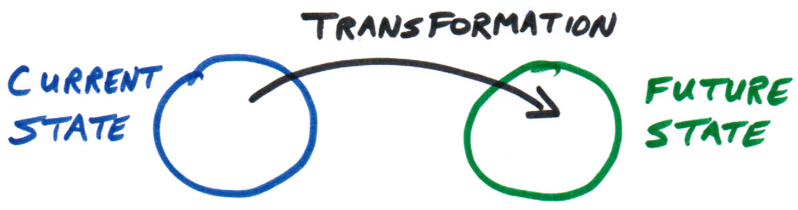
Data Transformation
4 Crucial Steps:
Tokenize: Process of breaking a stream of text up into words, phrases, symbols, or other meaningful elements called Tokens.
Removing Stop words: Stop words usually refer to the most common words in a language, any group of words can be chosen as the stop words for a given purpose.
Stemming: A stemming algorithm reduces words to the root word.
Removing recurring characters and punctuation's.

Slide 7
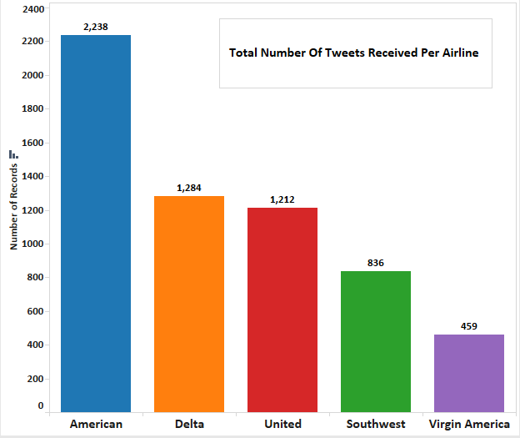
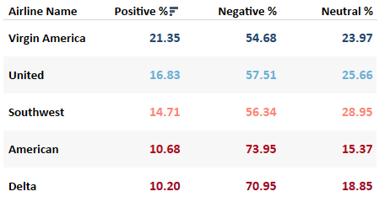
Who is the best ??

Slide 8
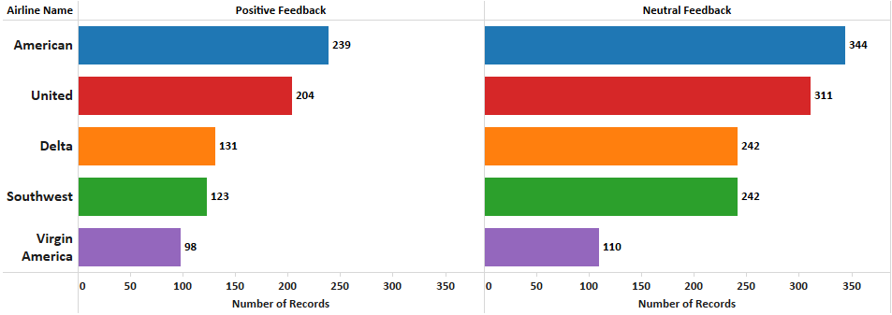

Slide 9
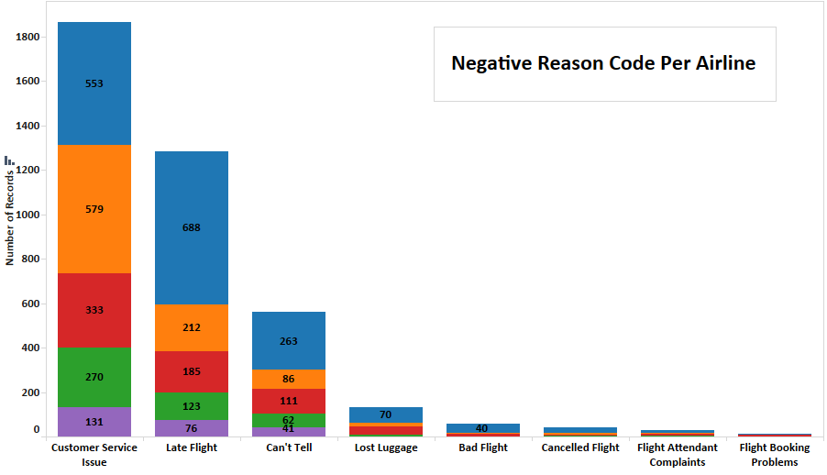
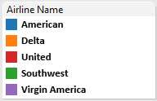

Slide 10


